Slide 1

Program Loops
LLOYD CHUNGA

Slide 2
Iteration Essentials
  A loop is a group of instructions the computer repeatedly executes while some loop-continuation condition remains true.
  The are two means of Iteration:
    Counter-controlled iteration.
    Sentinel-controlled iteration.

Slide 3
Counter-controlled iteration
  Counter-controlled iteration, also known as definite iteration, is a loop that repeats a block of code for a specific number of times. It uses a counter variable to keep track of the number of iterations. The loop continues until the counter reaches a predetermined value.
  Here's an example of counter-controlled iteration using a for loop in C:
                for (int i = 0; i < 5; i++) {
                // Code to be repeated
                }
  Counter-controlled iteration is useful when you know in advance how many times you want the loop to run.

Slide 4
Sentinel-Controlled iteration
  Sentinel-controlled iteration, also known as indefinite iteration, is a loop that repeats a block of code until a specific condition is met.
  It uses a sentinel value as a condition to control the loop's execution.
                int number;
                while (number != -1) {
                // Code to be repeated
                }
  Sentinel-controlled iteration is useful when you don't know in advance how many times the loop needs to run, and you want to continue the loop until a specific condition is met.
  It is often used when reading input from a user until a specific value or signal is encountered.

Slide 5
Types of Iterations (Loops)
  C programming has three types of loops:
    for loop
    while loop
    do...while loop

Slide 6
For Iteration Statement (for loop)
  The for iteration statement handles all the details of counter-controlled iteration.
  How for loop works?
    The initialization statement is executed only once.
    Then, the test expression is evaluated. If the test expression is evaluated to false, the for loop is terminated.
    However, if the test expression is evaluated to true, statements inside the body of the for loop are executed, and the update expression is updated.
    Again the test expression is evaluated. This process goes on until the test expression is false. When the test expression is false, the loop terminates.
  This process goes on until the test expression is false. When the test expression is false, the loop terminates.

Slide 7
General Format of a for Statement
  The general format of the for statement is
          for (initialization; loopContinuationCondition; increment) {
          statement
          }
  where
    initialization names the loop’s control variable and provides its initial value,
    loopContinuationCondition determines whether the loop should continue executing, and
    increment modifies the control variable’s value after executing the statement so that the loop-continuation condition eventually becomes false.

Slide 8
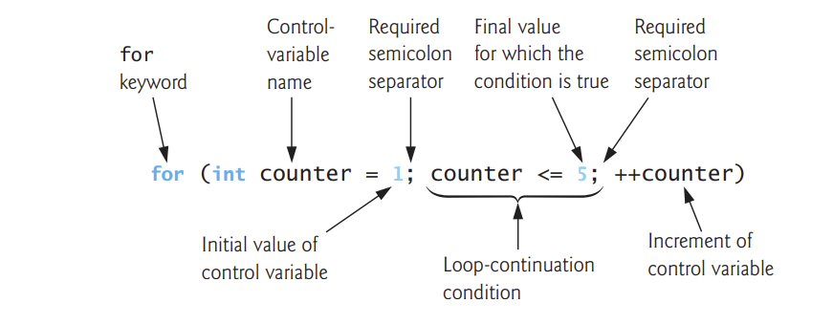
for Statement Header Components

Slide 9
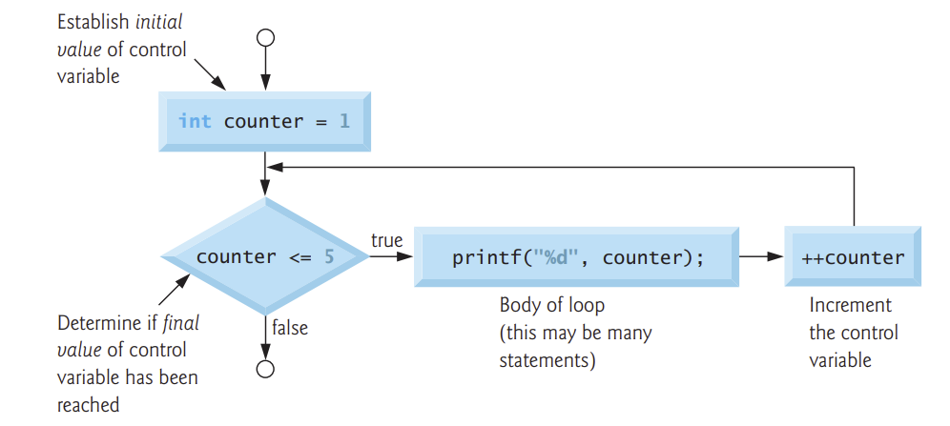
For statement flow chart

Slide 10
For statement: example 1
      #include <stdio.h>
      int main() {
      for (int i = 0; i < 5; i++) {
      printf("%d\n", i);
      }
      return 0;
      }

Slide 11
The while iteration Statement
  The while iteration statement specifies that an action repeats while a condition is true.
  Eventually, the condition will become false. At this point, the iteration terminates, and the first statement after the iteration statement executes.
  The syntax of the while loop is:
                while (testExpression) {
                // the body of the loop
                }

Slide 12
How while loop works?
  The while loop evaluates the testExpression inside the parentheses ().
  If testExpression is true, statements inside the body of while loop are executed. Then, testExpression is evaluated again.
  The process goes on until testExpression is evaluated to false.
  If testExpression is false, the loop terminates (ends).

Slide 13
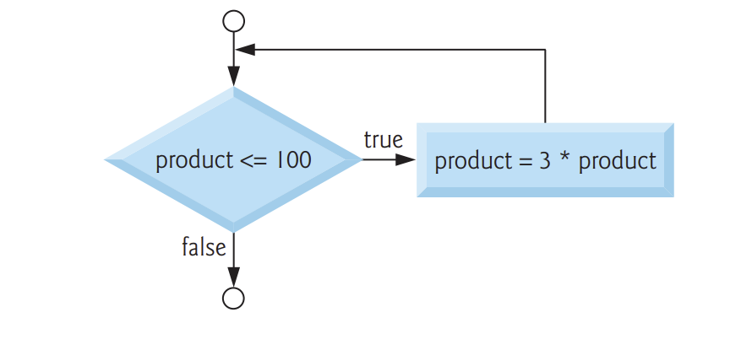
while Statement Flowchart
  The following flowchart segment illustrates the preceding while iteration statement:
int product = 3;
while (product <= 100) {
product = 3 * product;
}

Slide 14
The do…while Iteration statement
  The do…while iteration statement is similar to the while statement.
  The while statement tests its loop-continuation condition before executing the loop body.
  The do…while statement tests its loop-continuation condition after executing the loop body, so the loop body always executes at least once.
  When a do…while terminates, execution continues with the statement after the while clause.
                do {
                // Code to be executed and repeated
                } while (testExpression);

Slide 15
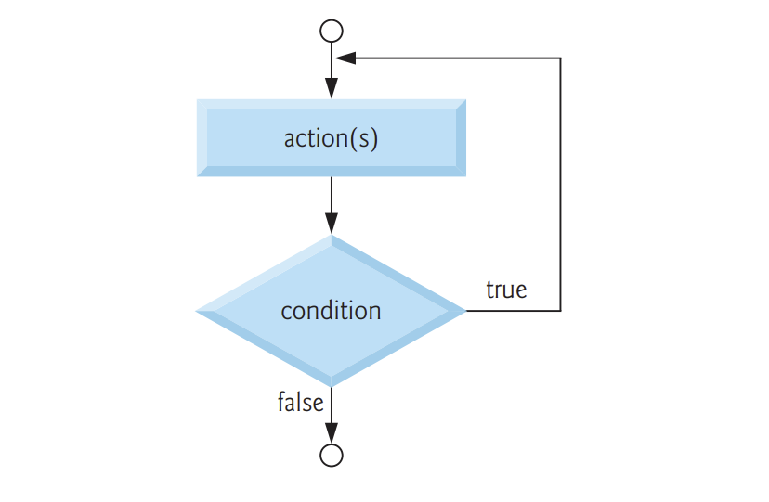
do…while Statement Flowchart
  The following do…while statement flowchart makes it clear that the loop-continuation condition does not execute until after the loop’s action is performed the first time:

Slide 16
break and continue Statements
  The break and continue statements are used to alter the flow of control.
  The break Statement:
    The break statement, when executed in a while, for, do…while or switch statement, causes an immediate exit from that statement.
    Program execution continues with the next statement after that while, for, do…while or switch.
    Common uses of break are to escape early from a loop or skip the remainder of a switch
    for (int x = 1; x <= 10; ++x) {
    if (x == 5) {
    break;
    }
    printf("%d ", x);
    }
    printf("\nBroke out of loop at x == %d\n", x);

Slide 17
break and continue Statements
  he continue Statement:
    The continue statement, when executed in a while, for or do…while statement, skips the remaining statements in that control statement’s body and performs the next iteration of the loop.
    In while and do…while statements, the loop-continuation test is evaluated immediately after the continue statement executes. In the for statement, the increment expression executes, then the loop-continuation test is evaluated.
    for (int x = 1; x <= 10; ++x) {
    if (x == 5) {
    continue;
    }
    printf("%d ", x);
    }
    printf("\nUsed continue to skip printing the value 5");

Slide 18
Switch Statement
  Occasionally, an algorithm will contain a series of decisions that test a variable or expression separately for each of the integer values it may assume, then perform different actions. This is called multiple selection.
  C provides the switch multiple-selection statement to handle such decision making.
  The switch statement consists of a series of case labels, an optional default case and statements to execute for each case.
  Switch statement uses the following syntax:
                switch(expression) {
                case x:
                // code block
                break;
                case y:
                // code block
                break;
                default:
                // code block
                }

Slide 19
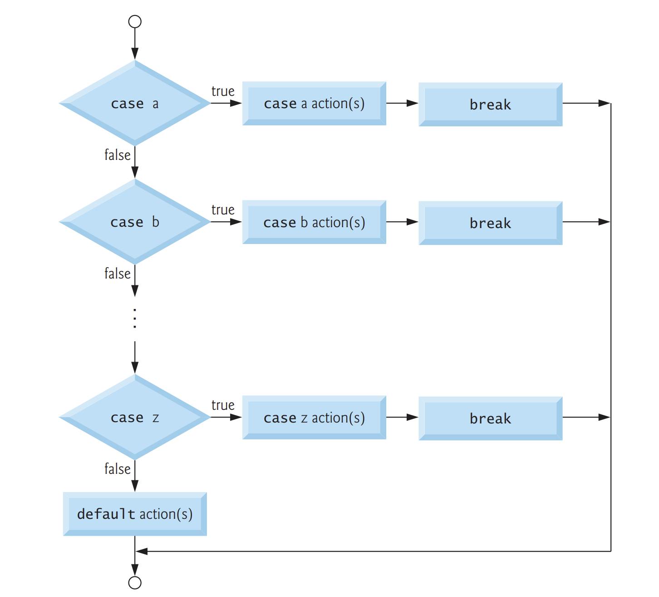
Switch Statement Flowchart
  The following switch multiple-selection-statement flowchart makes it clear that each case’s break statement immediately exits the switch statement.

Slide 20
C goto statement
  The goto statement allows us to transfer control of the program to the specified label.
  Syntax of goto statement:
  goto label;
  ... .. ...
  ... .. ...
  label:
  statement;
  The label is an identifier. When the goto statement is encountered, the control of the program jumps to label: and starts executing the code.

Slide 21
Practical Sessions

